Slide 1
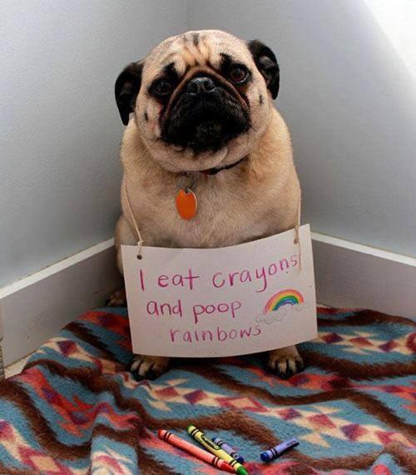

Slide 2
Dr. Dawn Ewing Private Practice in Spring, Texas Executive Director for The International Academy of Biological Dentistry and Medicine
PhD in Integrative Medicine
Board Certified Naturopath
Certified Homeopath
Licensed Paramedic
Licensed Dental Hygienist
Certified Clinical Thermographer

Slide 3
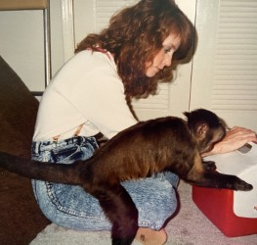
State Appointments
Texas State Board of Dental Examiners- 1982

Slide 4
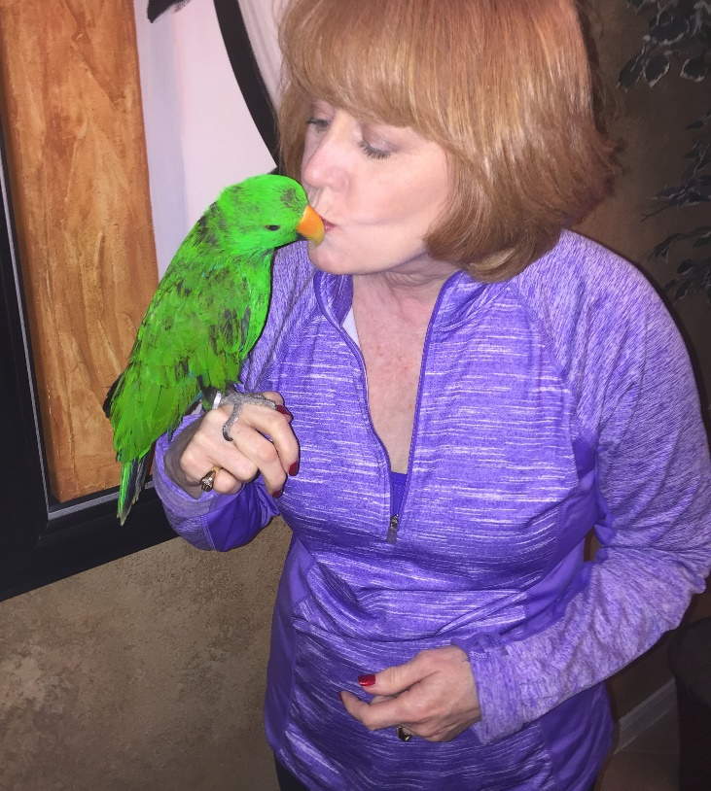
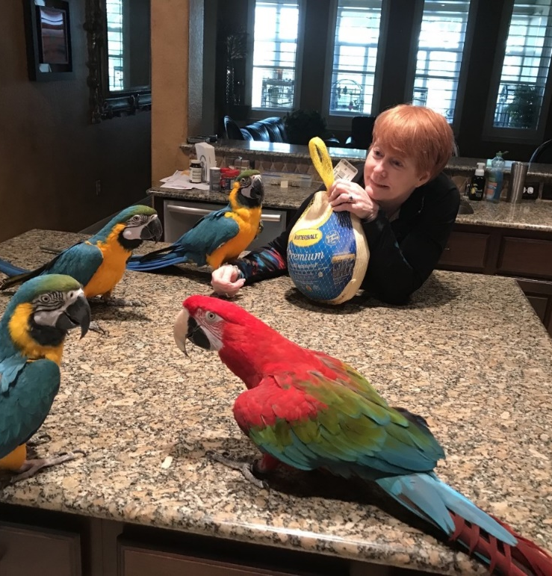
Teaching
Capital University of Integrative Medicine, Faculty Academy of Bioenergetics, Faculty Continuing Education University, Faculty American Heart Association, Affiliate Faculty Institute of Natural Dentistry, Instructor

Slide 5
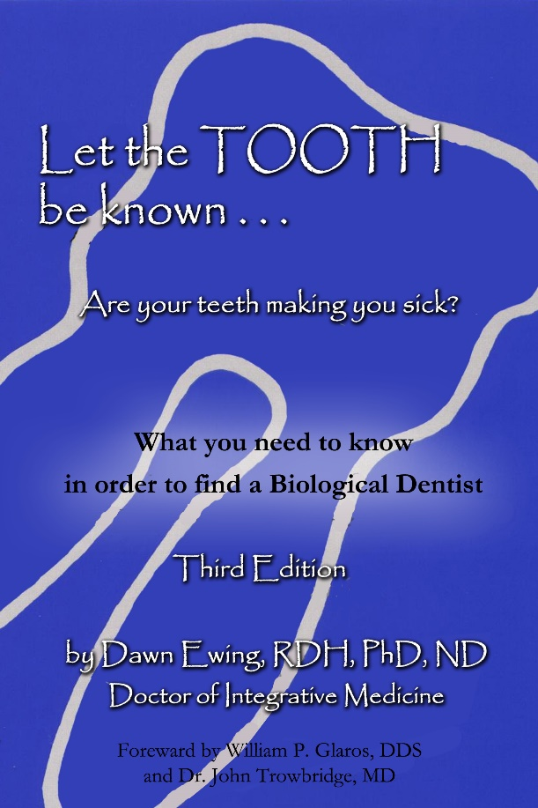
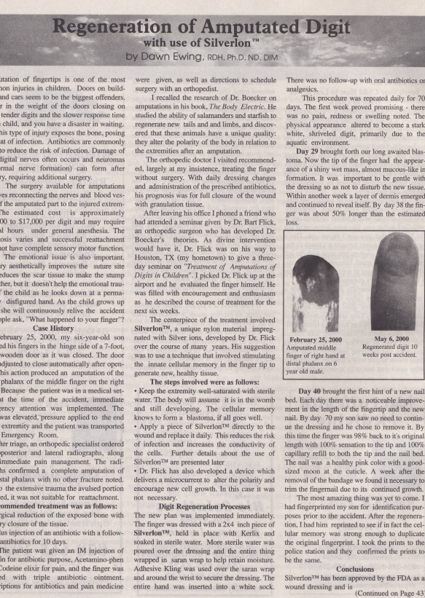
Publications
Let the Tooth Be Known (book) “Bioenergetics.” Carolina Health and Healing, 8 (2001) “Regeneration of Amputation Using Silverlon.” Carolina Health and Healing, 7 (2001) “Nattokinase.” DAMS newsletter (2003)

Slide 6
Media Appearances
Radio Extreme Health Radio: “The Dangers Of Mercury Fillings & How Oral Health Is Connected to Your Overall Health
Oral Health Summit with Jonathon Landsman
Television Appearances Debra Duncan Show, ABC-13, Houston TX: “Let the Tooth Be Known”
Debra Duncan Show, ABC-13, Houston TX: “Modern Day Medical Miracles”
Gerry Cornejo Show (Philippines, 2015)
Movie:
Root Cause 2018

Slide 7
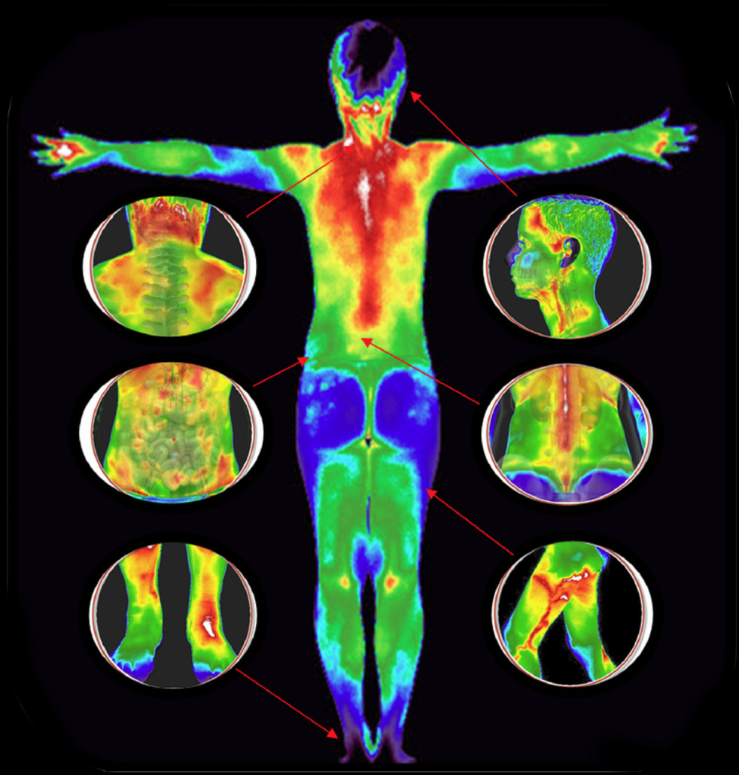
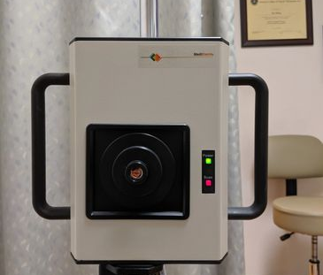
THERMOGRAPHY
Thermography is a no-contact, non-invasive procedure which captures and records temperature variations on the skin.
Dr. Dawn Ewing PhD

Slide 8
THERMOGRAPHY
Thermography uses an infrared camera to convert heat emitted from the skin surface into electrical impulses that are visualized in color to quantify changes in skin surface temperature
The spectrum of colors indicate an increase or decrease in the amount of heat being emitted from the body surface.
Thermography measures the somatic component of the sympathetic nervous system by assessing dermal blood flow.

Slide 9
The colors reflect the differing temperatures
White is the hottest, then red, orange, yellow, green, blue and black is the coldest

Slide 10
There Is Not A Good Or A Bad Color!
Red or White imply inflammation as there is more warmth.
Dark Blue or Black would imply poor circulation or a colder area.
This CAN NOT Be used to diagnose a cavitation. Most cavitations are avascular and would be cooler. (OLD IS COLD, HOT IS NOT)
Just like a thermometer can tell you the person is 99.2 or 104, It can NOT say that the person has appendicitis or meningitis.

Slide 11
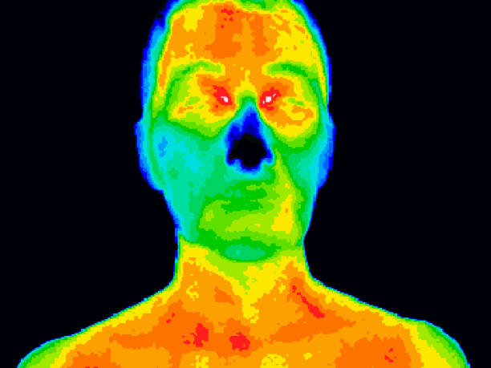
The Body Is Symmetrical (except you only have 1 heart)

Slide 12
Colors can be clues Blue vs Red

Slide 13
Compare Right to Left, The Right is warmer!

Slide 14
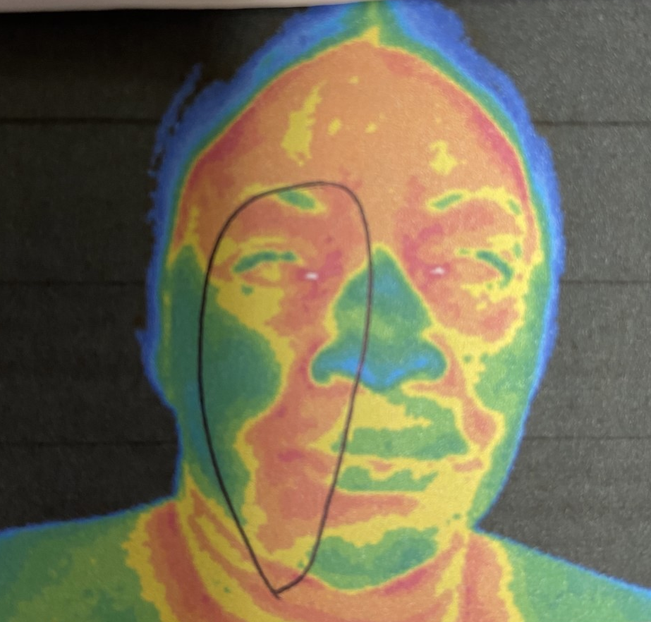
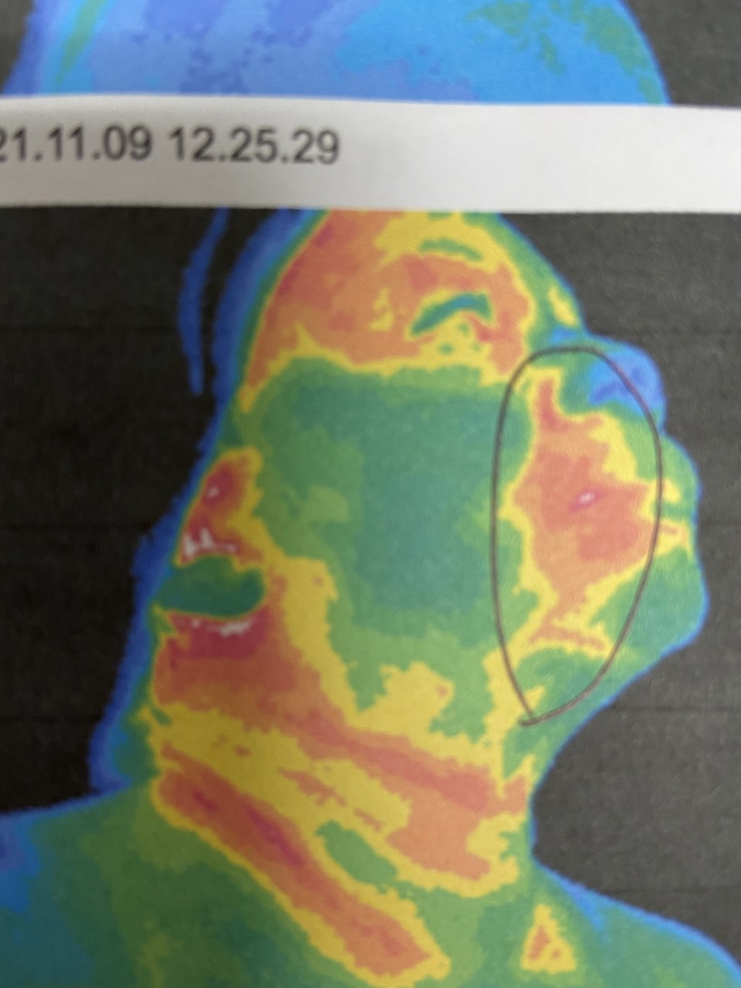
Here again we see more inflammation on the right side
Frontal view, more warmth on patient’s right
Patient’s Left side
Patient’s Right side

Slide 16
Caffeine Is A Drug Fibro-Cystic Tissue In Breasts Can React

Slide 17
No Caffeine and On Caffeine

Slide 18
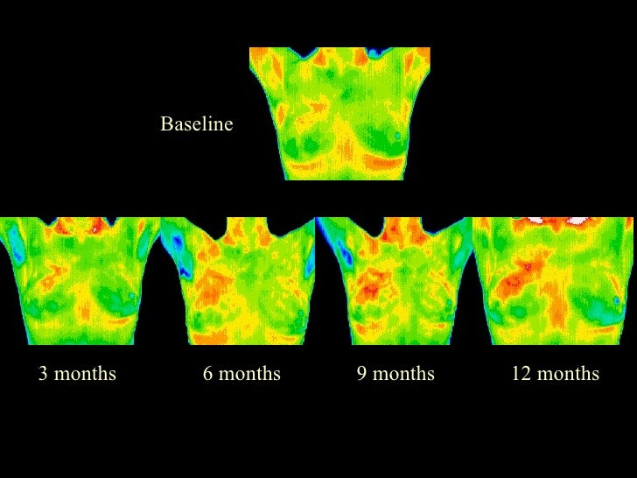
An example of watching inflammation get worse

Slide 19
Let’s look at the Lymphatics
The lymphatic system doesn’t have a pump, like the heart. So, lymph is moved upwards from the body’s tissues to the neck by the movements of the muscles.

Slide 21
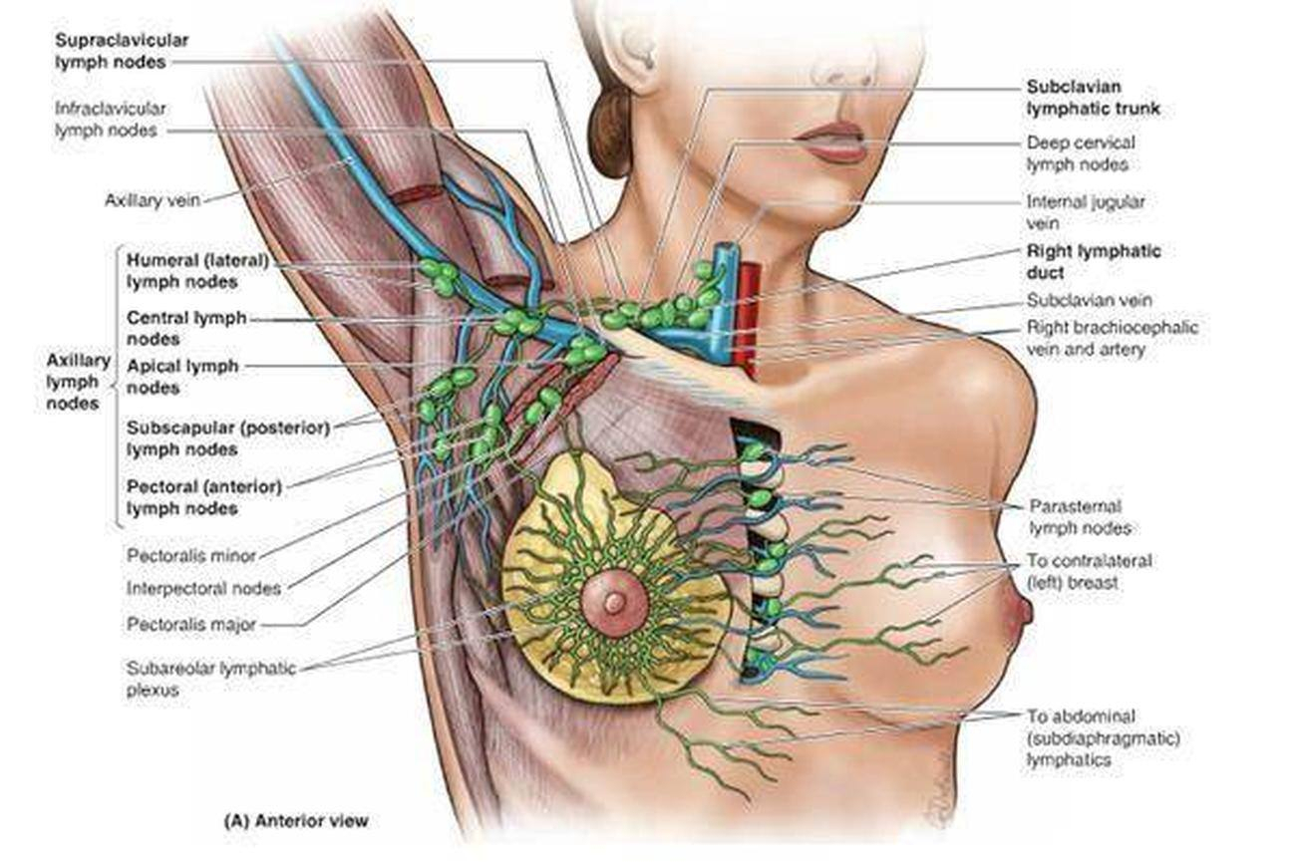

Slide 22
I have been looking at dental infections and breast health for many years. Everything from Root Canals to Bras that are too tight. One person, CAN MAKE A DIFFERENCE! Let me show you!

Slide 24
Nitric Oxide Can Increase Blood Flow
Simple to use:
Cream applied to skin or a lozenge under the tongue.

Slide 25
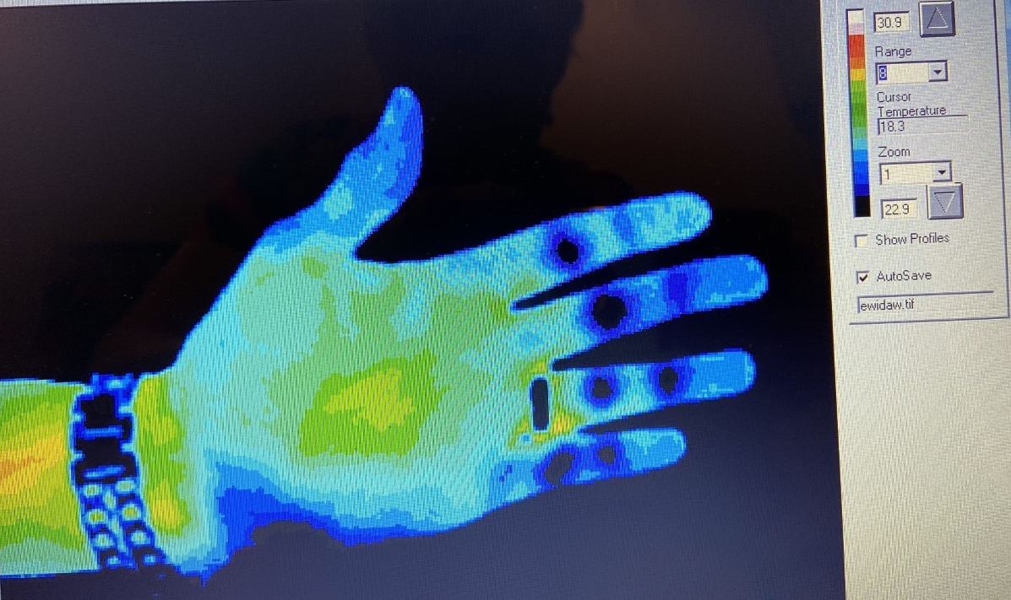
My hand BEFORE and 45 min AFTER taking NO lozenge
Note: Both Temps of camera are 30.9 so I could prove the improvement after ingesting the Nitric Oxide Lozenge. The increased dilatation of blood vessels, increased blood flow to the fingers.

Slide 26
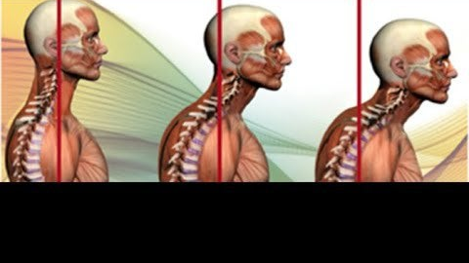
Evaluating Posture And Screening Airway

Slide 27
This Is An Example Of Good Posture We still see more inflammation on the left

Slide 28
What do you see?
Notice the head forward posture?
The area of #1? Her ear is warmer on the right.
You can even trace the carotid artery on the left.

Slide 29
2021 May 13;21(1):260.
doi: 10.1186/s12903-021-01618-9.
Thermography as a non-ionizing quantitative tool for diagnosing periapical inflammatory lesions
M Atef Aboushady ¹ ², Wael Talaat ³ ⁴ ⁵, Zaid Hamdoon ⁶, Tarek M Elshazly ², Nivin Ragy ⁷, Christoph Bourauel ^{# 2}, Sameh Talaat ^{# 2 8}
Affiliations
PMID: 33985486
PMCID: PMC8120841
DOI: 10.1186/s12903-021-01618-9
Abstract
Background: Thermography is a contemporary imaging modality based on acquiring and analyzing thermal data using non-contact devices. The aim of the present study was to assess the validity of thermography, compared with that of the reference-standard, for the diagnosis of periapical inflammatory lesions and to evaluate the temperature ranges for acute pulpitis with apical periodontitis (AAP), acute periapical abscess (AA) and chronic periapical abscess (CA).
Methods: AAP, AA and CA were diagnosed based on clinical and radiographic criteria. Thermographic data were acquired using the FLIR E-5 Infrared Camera. Extraoral thermal images were taken from the front and right and left sides of patients whose mouths were closed, and one intraoral thermal image was taken from the palatal perspective. Agreement in the diagnoses based on the combination of clinical and radiographic assessments and the thermographic evaluation was calculated. The temperature ranges of the three diagnostic subgroups were also measured.
Results: A total of 80 patients were enrolled in this study. The mean intraoral thermal image temperature for AA was 37.26 ± 0.36, that for CA was 35.03 ± 0.63 and that for AAP was 36.07 ± 0.45. The differences between the mean intraoral thermal temperatures of the three diagnostic groups were statistically significant (P < 0.001). The result of the Kappa coefficient of agreement between the combination of clinical and radiographic assessments and the thermographic evaluation was significant (P < 0.001).
Conclusions: Thermography is an effective, quantitative and nonionizing approach that can be used for the diagnosis of periapical inflammatory lesions. The results of the present study indicated that the highest thermal image temperatures were recorded for AA. Thermography might be able to detect inflammatory reactions during the preclinical stage, leading to early diagnosis.

Slide 30
Notice The Area of #14?

Slide 31
#14 Happens To Be A Root Canal

Slide 32
Referred From MD For Lump On Left Side Of Neck

Slide 33
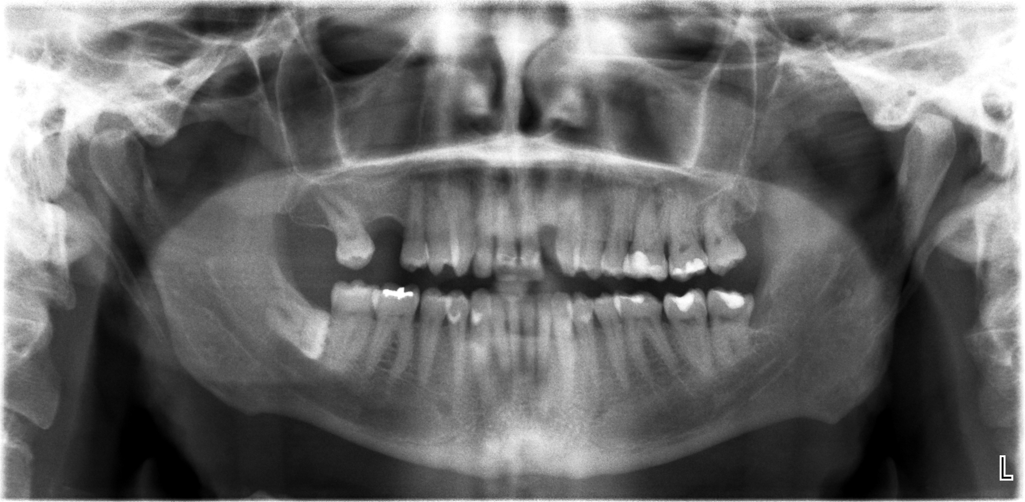
Here is his Panorex

Slide 34
Suspicious area at Apex of #14 and #15

Slide 35
This patient has an abscess on #13 and is scheduled to see a dentist. She came in due to a lump she found in her left breast.

Slide 36
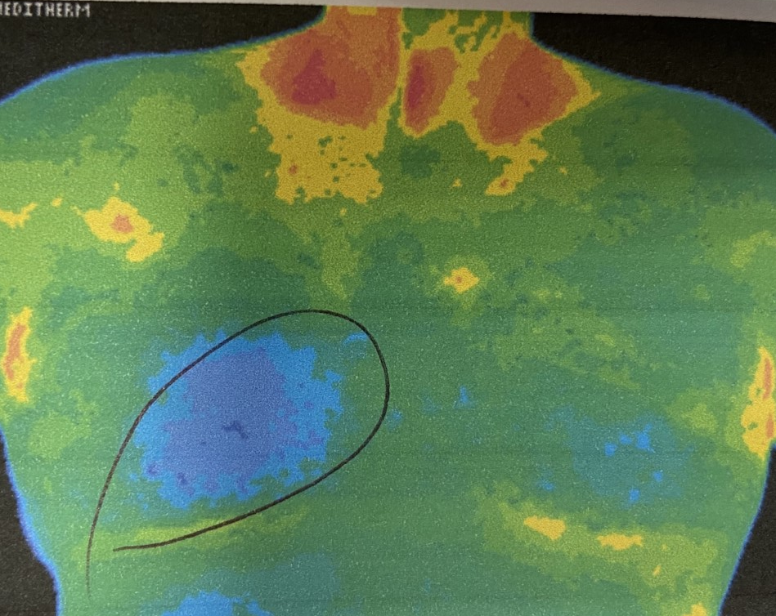
Anterior Mandibular, Both Ears, Gynecomastia

Slide 37
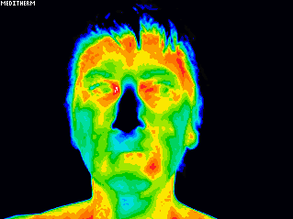
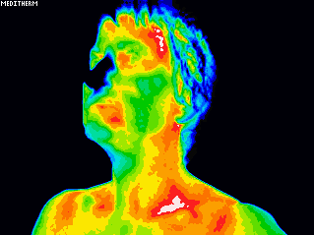
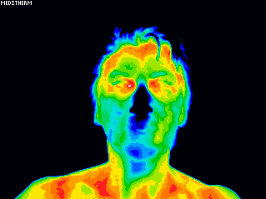
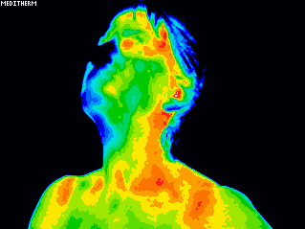
#18 abscess
October 2015
Image Taken
Prior To Extraction
October 2016
1 year After Extraction

Slide 38
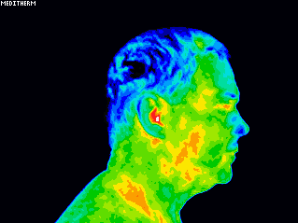
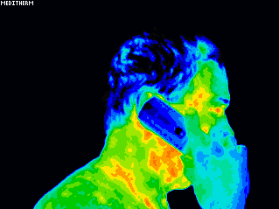
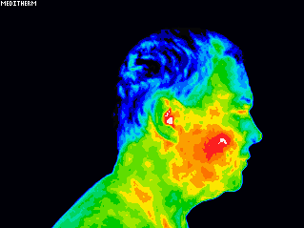
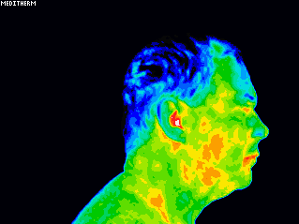
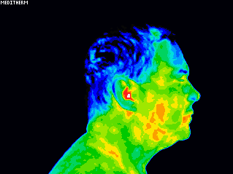
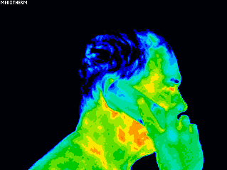
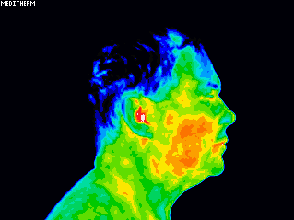
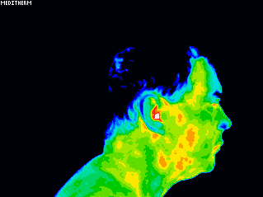
Baseline
Talking on phone After 5 min on phone 10 min later close to Base
Baseline Talking on phone 5 minutes of talking on phone 3 min later
w/emf protector close to base
Baseline Talking on phone 5min later 3 min later

Slide 39
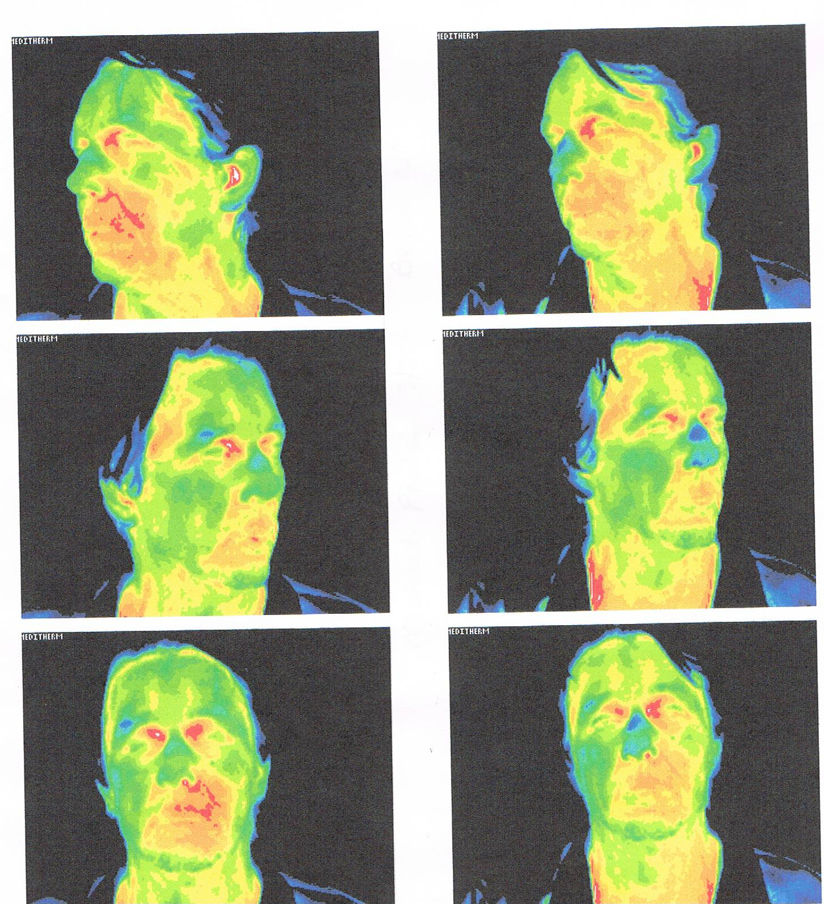
Chief Complaint : Trigeminal Neuralgia Upper Left Face.
Considering surgery to cut all nerves to his face.
Thermal imaging was done adjunctive to meridian stress assessment.
Dental foci tooth #11 Neural Therapy in area.
Tooth #11 is a root canal tooth that had re-infected but the patient has no symptoms.
3 minutes after NT, the patient was re-imaged. Pain was GONE!
Having this good response from the neural therapy allows the oral surgeon, or in this case his oral pathologist, watch the sympathetic response of his autonomic nervous system’s reaction to this tooth.
Not all problem areas are warm. Root canal teeth are dead and therefore they may image cooler. Areas where teeth have been extracted but have poor circulation of blood, called “Jawbone ischemia” are also cooler.

Slide 41
. 2018 Mar 10;10(3):e2298.
doi: 10.7759/cureus.2298.
Role of Thermography in the Diagnosis of Chronic Sinusitis
Raja Kalaiarasi ¹, Chellappa Vijayakumar ², Ramalingam Archana ³, Ramakrishnan Venkataramanan ⁴, Ranganathan Chidambaram ⁵, Sadhanandham Shrinuvasan ⁵, Ravi Prabhu ⁶
Affiliations
PMID: 29755895
PMCID: PMC5945270
DOI: 10.7759/cureus.2298
Abstract
Introduction Thermography is a form of radiography that images the skin surface temperature. Thermograms are pictorial representations of thermal maps of the entire body's outer surface. Thermography was applied as an attempt to evaluate its usefulness in the diagnosis of chronic sinusitis (CS). Hence, this study was done to determine the diagnostic value of thermography for patients suffering from CS. Methodology Patients attending the Department of Otorhinolaryngology and Head and Neck Surgery over a two years' duration with symptoms suggestive of CS were included in this diagnostic evaluation study. X-ray paranasal sinuses (PNS) and nose, thermography of head and neck, and computed tomography (CT) of PNS and nose (axial and coronal sections) were performed on them. The thermograms and X-ray sinuses obtained were compared with the computed tomography of PNS findings. Results The study population consisted of 167 patients (75 males and 92 females) and the mean age of the study population was 38.6 years. The sensitivity and specificity of thermography of the head and neck in diagnosing frontal, ethmoidal, maxillary, and sphenoidal sinusitis were 92.59% and 68.58%, 100% and 66.32%, 70.06% and 85.88%, 99.18% and 0%, respectively. Whereas the sensitivity and specificity of the X-ray PNS and nose in diagnosing frontal, ethmoidal, maxillary, and sphenoidal sinusitis were 92.59% and 77.88%, 73.61% and 81.05%, 89.19% and 98.92%, 74.44% and 99.18%, respectively. Conclusion Thermography is better than X-rays in diagnosing frontal and ethmoidal sinusitis and as good as X-ray PNS and nose in diagnosing maxillary sinusitis. Thermography failed to pick up sphenoidal sinusitis. The advantages of thermography are that it is a radiation-free, non-invasive, and cost-effective method for diagnosing CS.

Slide 43
2019 Jul;2019:5498-5501. doi: 10.1109/EMBC.2019.8856801. Using Thermography as Auxiliary Tool to Thyroid Cancer Diagnosis: a Case Study V M B Camargo, H Gamba, E F R Romaneli, L Ulbricht PMID: 31947099 DOI: 10.1109/EMBC.2019.8856801
Abstract
The diagnostic medicine evolves and takes benefit from the development of technology constantly. New therapeutic modalities are studied in the area of oncology in order to assist, evaluate, and monitor the diagnosis of cancer. The thyroid cancer is a disease that has increased in incidence and mainly affects women. Infrared thermography is an imaging technique that helps to diagnose several kinds of cancer as shown in several researches. It is useful for monitoring therapeutic procedures and detecting the appearance of new nodes. Its effectiveness depends on the use of correct protocol of acquisition and analysis of the images and precise assessment of thermograms. This work focuses on checking the viability of thermal imaging in the evaluation of thyroid cancer recurrence. A female patient presented right lobectomy of the thyroid gland and diagnosed with adenoma in the upper third of the left lobe of the thyroid participated in the study. The dynamic thermography under cold stressing was used. The analysis of variation rate and the average difference of temperature in the cancerous tissue (left lobe) comparing to the healthy tissue (isthmus) were performed. Forty photos were evaluated during fifteen minutes. The images were taken every ten seconds in the first five minutes. The temperature variation rate increased in both regions during this time according to the results. The average of temperature difference, compared to the healthy tissue (isthmus) after cold stressing is 1.0º C after 5 or 10 minutes and 0.8ºC after 15 minutes. The temperature ripple was higher on the healthy tissue (5°C) than on the cancerous one (3.6ºC) right after cold stressing. Thermography seems to be effective in detecting the new thyroid nodule in the left lobe.

Slide 44
Let me leave you with an “OUT OF THE BOX” thought

Slide 45
This is what we were trained to do.
Detect decay and address it.
Why is #20 decayed and not 19?

Slide 46
What if we dug a little deeper and found a possible REASON?

Slide 48
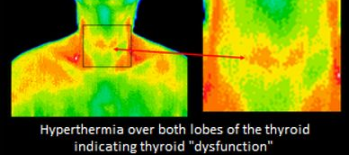
What if something going on with the thyroid, caused only specific teeth to decay?

Slide 49
Reducing Inflammation Is Our Goal
Nitric Oxide- causing vasodilatation and increases oxygenation.
Ozone- Reduces inflammation, antiviral, antibacterial, antifungal, antiparasitic, increases oxygenation.
Removing pathogens- we will learn about specific bacteria this weekend.
What if it means referring out to gather more data. Ie: Labs, thermography? Like finding out a patient has a thyroid problem so severe that their immune system is taxed.

